Slide 1
Real-Time Streaming Analytics
An On-Premise, Scalable, Geo-Distributed Solution
Boni Bruno, CISSP, CISM, CGEIT
Chief Solutions Architect | Emerging Technologies

Slide 2


I’ll be describing an architecture for performing near real-time streaming anomaly detection on security events.
Apache Kafka, Spark, Flume, Zeppelin, and Dell EMC Elastic Cloud Storage (ECS) is used to build a scalable, geo-distributed, and highly reliable system.
This system will generate alerts within 5 seconds after an anomaly is detected from any deployed security device.

Slide 3
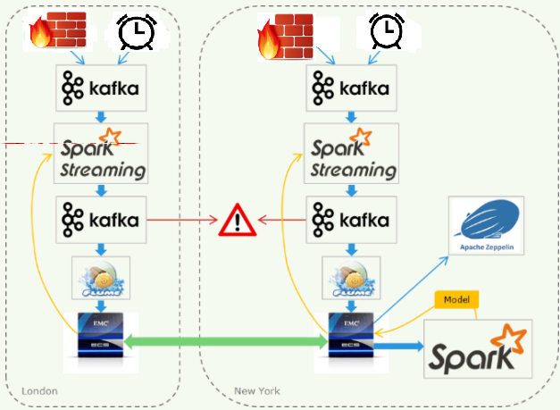
Messages from “things” are sent to Kafka
A Spark Streaming job receives messages, enriches them, performs near real-time anomaly detection, and sends the enriched data to Kafka.
Flume persists the enriched data to an ECS bucket.
ECS replicates the entire bucket to other sites.
Data scientists can explore and visualize the global dataset using Zeppelin.
A nightly Spark batch job executes on the entire global dataset stored on ECS to produce a machine learning model that detects anomalies.

Slide 4

Apache Kafka
In short, Kafka provides a distributed and reliable message bus.
Each Data Center has its own Kafka cluster to ensure functionality in the event of communication failure between data centers.
Kafka will replicate messages among its nodes to ensure they are protected from hardware or other failures.
See what Dell EMC is doing in this space with http://pravega.io/, https://github.com/pravega

Slide 5


A note about Python
Today, Spark applications can be written in Scala, Java, Python, and R. All of the coding needed for this system is done in Python.
According to a recent survey by Stack Overflow, 63% of data scientists use Python.
It's also extremely popular in the scientific computing, dev ops, operating systems, and with those of us who want to automate tasks of nearly any sort.
You will find that there are some things that can only be done in Spark using Scala but with each release of Spark, you'll be able to do more and more with Python.
The Python that comes standard on nearly all versions of Linux usually does not include the libraries that data scientist use most often - Numpy, Pandas, Scikit-learn, Matplotlib, etc. Although these packages can be added to your default Python installation, the easiest way to get all of these libraries is by installing Anaconda Python.

Slide 6
KDD Cup 1999 Data
The KDD Cup 1999 data set.was used in a competition to build a network intrusion detector.
The data is essentially what you might expect to receive from a network router and contains fields such as the protocol type, number of bytes sent/received, packet flags, and session duration.
This data set in particular is often used to develop anomaly detection systems, which is a key part of a typical network intrusion detection system.
You will find that there are some things that can only be done in Spark using Scala but with each release of Spark, you'll be able to do more and more with Python.
The KDD Cup 1999 data consists of nearly 5 million records in a CSV file. The first record is:
0,tcp,http,SF,215,45076,0,0,0,0,0,1,0,0,0,0,0,0,0,0,0,0,1,1,0.00,0.00,0.00,0.00,1.00,0.00,0.00,0,0,0.00,0.00,0.00,
0.00,0.00,0.00,0.00,0.00,normal.

Slide 7
Building a Data Generator for Testing
See the Python streaming_data_generator.py script.
Note that this script and all other required files are in the GitHub repo: https://github.com/bonibruno/Anomaly-Detection-
Reads the entire KDD Cup 1999 CSV file into memory. It is 709 MB so this only takes about 10 seconds. This makes use of the excellent Pandas library to read the CSV file into an in-memory data frame (not a Spark data frame).
Loop forever:
Pick a random record from our dataframe.
We add a timestamp, a unique UUID, an incrementing sequence ID
Convert the record to JSON.
Send the record to the Kafka topic named sensor_messages.
Sleep long enough to limit our send rate as desired. This is done with a token bucket.

Slide 8
Kafka Topics
Each Kafka cluster has the following topics in our system:
sensor_messages: This topic will contain the messages sent by the sensors. In our case, the data generator will publish the synthetic data to this topic. It will be consumed by our Spark Streaming job.
enriched_data: This topic will contain the enriched data. Each message in this topic will contain a single sample. In our case, Flume will consume the messages in this topic and persist them to reliable storage.
alerts: When the anomaly detector predicts that a message is an anomaly, that message will be published to this topic. Our Zeppelin dashboard will continually show the most recent contents of the alerts topic.

Slide 9
Kafka Performance Considerations
It will be important to manually create the topics ahead of time so that we can specify the optimal number of partitions and the replication factor.
You should have enough partitions so that the topic can be parallelized across the broker and consumer instances.
As a rule of thumb, the number of partitions will be dictated by rate of the slowest consumer.
For example, if the topic receives 1000 messages/sec and your slowest consumer can process 10 message/sec, then you will need a minimum of 100 consumers and 100 partitions so that each consumer gets a distinct partition.

Slide 10
Kafka Replication Factor
The replication factor of three will replicate the messages across three Kafka nodes, allowing any two to die before messages become lost.
To create the topics, use the commands below:
$ kafka-topics.sh --zookeeper zk.example.com:2181 --topic sensor_messages --create --partitions 4 --replication-factor 3
$ kafka-topics.sh --zookeeper zk.example.com:2181 --topic enriched_data --create --partitions 4 --replication-factor 3
$ kafka-topics.sh --zookeeper zk.example.com:2181 --topic alerts --create --partitions 4 --replication-factor 3
For non-production use, you may want to set the Kafka configuration property log.retention.bytes to something like 1 GB to put an upper-limit on the local disk space that Kafka uses.

Slide 11
sensor_messages
$ kafka-console-consumer.sh --zookeeper zk.example.com:2181 --topic sensor_messages --max-messages 1
{"num_access_files": 0, "src_bytes": 230, "srv_count": 26, "num_compromised": 0, "rerror_rate": 0.0, "urgent": 0, "dst_host_same_srv_rate": 1.0, "duration": 0, "label": "normal.", "srv_rerror_rate": 0.0, "srv_serror_rate": 0.0, "is_host_login": 0, "wrong_fragment": 0, "uuid": "8238af16-9942-43d2-a541-1756929a37ef", "service": "http", "serror_rate": 0.0, "num_outbound_cmds": 0, "is_guest_login": 0, "dst_host_rerror_rate": 0.0, "dst_host_srv_serror_rate": 0.0, "diff_srv_rate": 0.0, "hot": 0, "dst_host_srv_count": 255, "logged_in": 1, "num_shells": 0, "dst_host_srv_diff_host_rate": 0.040000000000000001, "index": 1358500, "srv_diff_host_rate": 0.19, "dst_host_same_src_port_rate": 0.01, "root_shell": 0, "flag": "SF", "su_attempted": 0, "dst_host_count": 117, "num_file_creations": 0, "protocol_type": "tcp", "count": 8, "utc": "2016-04-08T22:59:44.978076", "land": 0, "same_srv_rate": 1.0, "dst_bytes": 2446, "sequence_id": 1654094, "dst_host_diff_srv_rate": 0.0, "dst_host_srv_rerror_rate": 0.0, "num_root": 0, "num_failed_logins": 0, "dst_host_serror_rate": 0.0}

Slide 12
Spark Streaming – Real-Time Anomaly Detection
Spark Streaming functions as a complex event processor. Use it to perform complex data enrichment and to evaluate learning models like Random Forests and Artificial Neural Networks.
Our Anomaly Detection Spark Job does the following:
Pull messages from Kafka topic and create mini-batches of messages every few seconds.
For each mini batch, enrich data - join datasets, perform calculations, identify geo-location, etc.
We want the enriched data to persist to reliable storage (ECS). Although Spark can write directly to HDFS, doing so will result in many small files (performance penalty). It’s better to send data to a different Kafka topic and use flume to create large files and regularly write to out to the storage file system.
The enriched data will be transformed into features (e.g. convert categorical data into real numbers).
For each message, the features will be used as inputs into our ML Model, the output will reflect whether the message is predicted to be an anomaly.
If an anomaly is predicted, the job will then send an alert. This can be an alert message sent to a different Kafka topic than an outside alerting system monitors…
Notes:
Isilon, acquired by EMC in 2010, has grown to well over $1 billion in annual revenue. Some of our recent achievements were that we are ranked #1 with analysts in several areas including maintaining our market-leader position in Scale-out NAS, the leader in Hadoop shared storage, and the leader in Data Lake storage. Isilon has achieved significant YoY growth of over 20%, which is a testament to Isilon providing effective solutions to current IT challenges. We now have over 7000 customers with 1000 new customers last year. As you can see, many of our customers are using Isilon as their platform for Big Data storage and analytics. One internal achievement is that Isilon has the record for the largest single order for storage, over 100PB!

Slide 13
EMC Elastic Cloud Storage (ECS)
At this point we have our enriched data in multiple files in a single geo-distributed ECS bucket. The primary copy of each object (file) will physically remain within the data center where it originated.
Other data centers throughout the world will contain exactly enough parts of the erasure-coded objects so that an object can be rebuilt in the event of a data center failure.
Specifically, Reed-Solomon erasure coding is used within a datacenter and parity (XOR) is used between data centers. This greatly reduces the storage requirements but retains a high degree of data protection.
If you where to browse an ECS bucket (e.g. hdfs dfs –ls), you would see files created from the Spark Streaming Job running in each data center.
These features of ECS make it extremely simple to run high-performance analytics/jobs across an entire global data set! You only need to point your job to read the files in a single directory and ECS will take care of the WAN transfer, local caching, cache invalidation, consistency, disaster recovery, and high availability.

Slide 14
Spark – ML Model Training
We use the entire global data set to train our ML model to detect anomalies. To do this, we’ll create a Spark batch job to do the following:
Read the enriched data that was placed in our ECS bucket by the Flume job at each data center.
Train our ML Model. A single model will be created that uses the data collected by all data centers. This step may also include cross validation and hyperparameter (parameters whose values are set prior to the commencement of the learning process) tuning.
Save the model to files on ECS. Depending on the algorithm and hyperparameters we choose, the size could of our model on disk code may be a few KB to several GB’s.
Inform each of our Spark Streaming jobs to use the newly trained model saved on ECS.

Slide 15
spark_streaming_processor.py
We must create a Spark Streaming context. Below example tells Spark Streaming to create batches of 15 seconds which means every 15 seconds on multiples of 15 seconds (0, 15, 30, and 45 seconds after the beginning of each minute.
ssc = StreamingContext(sc, batchDuration=15)
We load the Random Forest machine learning model:
model = RandomForestModel.load(sc, 'viprfs://repbucket1.ns1.site/tmp/ecs_iot_demo2/model')
Note: This is skipped if a model hasn't been built yet. In that case, anomaly detection is disabled but enrichment and sending the enriched data to Kafka is still performed.

Slide 16
spark_streaming_processor.py
Next, we tell Spark Streaming that it should get input data from a Kafka topic.
kvs = KafkaUtils.createDirectStream(ssc, ['sensor_messages'], { 'metadata.broker.list':'kafka.example.com:6667',
'group.id': 'spark_streaming_processor.py'})
When Spark Streaming begins working, it's going to call our Python function process_messages() for each 15 second batch of messages. process_messages() begins by converting the RDD to a distributed Spark dataframe (not to be confused with a Pandas dataframe). Resilient distributed dataset (RDD) is a collection of elements partitioned across the nodes of the cluster that can be operated on in parallel.
df = sqlContext.createDataFrame(rdd)
A Spark dataframe is much easier to deal with than an RDD and it can often lead to better performance. One thing I love about dataframes is that all columns are named. This means I can simply refer to df.src_bytes instead of remembering that src_bytes is the 10th element of each tuple in the RDD. A data frame is a table, or two-dimensional array-like structure, in which each column contains measurements on one variable, and each row contains one case. A DataFrame has additional metadata due to its tabular format.

Slide 17
spark_streaming_processor.py
As a very simple example of data enrichment, the line below will add a calculated field named total_bytes that is simply the sum of bytes sent and received:
df = df.withColumn('total_bytes', df.src_bytes + df.dst_bytes)
Using Spark SQL, it is straight forward to perform other enrichment tasks including joining to local tables or distributed Hive tables. The result of the enrichment will be new columns added to the original dataframe.
We'll send the enriched data to the Kafka topic named enriched_data using the Python function write_partition_to_kafka().
Note: when initializing the Kafka producer, you'll want to reduce the parameter linger_ms from the default of 5000 to something like 10. If you leave it at the default, write_partition_to_kafka() will take a minimum of 10 seconds, even with only one record!

Slide 18
Spark Machine Learning
The Spark machine learning libraries expect a feature vector for each record so we use pyspark.ml.feature.VectorAssembler to create one.
The machine learning prediction happens in just one line - predictions_rdd = model.predict(features_rdd)
The predicted value is 1 for "normal" data and 0 for anomalies. So we can now simply filter the result to get only the anomalies:
anomalies_rdd = features_and_predictions_rdd.filter(lambda x: x[1] <= 0).map(lambda x: x[0])
anomalies = anomalies_rdd.collect()
print('Predicted %d anomalies' % len(anomalies))
The list of anomalies is sent to a Kafka topic named alerts. Each alert message is simply the JSON-encoded enriched data for that record. Since we don't expect a large number of anomalies, the driver (as opposed to the workers) collects the anomaly records and sends them to Kafka.
The Bash script spark_streaming_processor.sh can be used to launch the Spark Streaming Processor script with the correct parameters.

Slide 19
Spark Machine Learning Model Training
Training is implemented as the Python script batch_model_builder.py and it is executed by PySpark.
For our use case, it is important that our machine learning model consider all of the data from each of our data centers. Run this job at just one data center, it will read the enriched data that originated from each of our data centers. This job should run daily or weekly.
One one of advantages of using Spark is that the API for streaming is nearly identical to that of traditional Spark batch jobs. The first thing our Spark batch job does is read the enriched data that was placed in our ECS bucket by the Flume job at each data center.
df = sqlContext.read.json('viprfs://repbucket1.ns1.site1/tmp/ecs_iot_demo2/enriched_data/*/*')
Since ECS guarantees a consistent view of the data, this Spark job will see the entire data set up to the most recent flush by each of the Flume agents.

Slide 20
Spark Machine Learning Model Training
Next, the feature vector is created just as in our streaming job. The feature vector is then sent to our unsupervised Random Forest machine learning training algorithm. After waiting for a long time (approximately 3 hours when training on all 5 million records), it saves our model to the same replicated ECS bucket.
For the updated model to be used by the Spark Streaming job at each site, the Spark Streaming jobs will need to reload the model from the ECS bucket. This is not automated in the current implementation of this demo so the Spark Streaming jobs will simply need to be restarted.
To launch this job, you can use batch_model_builder.sh. This executes the following:
$ spark-submit \
--master yarn \
--deploy-mode client \
--driver-memory 4g \
--num-executors 4 \
--executor-cores 2 \
--executor-memory 8g \
--packages com.databricks:spark-csv_2.10:1.4.0 \
batch_model_builder.py \
--input_data_path ${ENRICHED_DATA_PATH}/*/* \
--data_format json \
--model_path ${MODEL_PATH}
Increase the executor parameters as desired to increase the resources available to the job. This job will use all of the resources that you provide it.

Slide 21
Unsupervised Random Forest
Most successful machine learning algorithms for this purpose are based on decision trees.
Decision trees are essentially a series of questions such as "is src_bytes < 50" and "is duration < 3.5". After each question, either another question is asked or a final value is returned as the prediction (anomaly or normal). The Random Forest algorithm uses a group (ensemble) of decision trees and aggregates the results with a simple majority vote (one tree, one vote!). Each tree in a Random Forest is trained on a random subset of the rows (samples) and columns (features).
We assume that all of the samples that we have ever seen are normal. We can then generate what we hope are anomalous samples by taking the value for field 1 from a random sample of our data, taking the value for field 2 from a different random sample of our data, and repeating this for each field and each new anomalous sample that we want to generate. This works surprisingly well.
The function to generate the synthetic anomalous samples is supervised2unsupervised() and is from Getting Started With Apache Spark.

Slide 22
Unsupervised Random Forest
The code to perform the model training is as follows:
unsupervised_forest = supervised2unsupervised(RandomForest.trainClassifier, fraction=0.1)
model = unsupervised_forest(features_rdd,
numClasses=2,
categoricalFeaturesInfo={},
numTrees=10,
featureSubsetStrategy='auto',
impurity='gini',
maxDepth=15,
maxBins=50)
You will notice that there are several parameters that were passed to our model training function (numTrees, maxDepth, etc.). These are called hyperparameters since they are not directly based on our data. (The parameters are essentially the questions and predictions in our decision trees.)

Slide 23
Hyperparameter Tuning
What are the best values of these hyperparameters?
This is one of the more difficult questions to address in machine learning.
The general approach is to try a variety of different values and then to pick the one set of values that gives you the best model.
So you may try numTrees=100, maxDepth=30 for one pass and then numTrees=30, maxDepth=15 for another pass.
If you wanted to try every possibility with numTrees={30,100,300}, maxDepth={15,20,25,30}, and maxBins={25,50} you would need to try 3*4*2=24 combinations.
If each one took 3 hours, that's 3 days of processing!

Slide 24
Hyperparameter Tuning
Of course, you'll also need to quantify how good each model is.
This is normally done by holding out 20% of the samples, training on the remaining 80% of the samples, and then comparing the model's prediction on the held out 20% to the actual values.
This can even be done five times by holding out a different 20% of the samples. This is called 5-fold cross validation and it would bring us to 15 days of processing - time to buy more hardware!
For those interested and willing to do a lot more learning, the grid search method described above can be replaced or supplemented with a more intelligent optimization method such as one that uses Yelp's MOE.
That said, the batch_model_builder.py script makes no attempt to tune the hyperparameters or to measure the quality of the model. That is left as an exercise for you. ☺

Slide 25
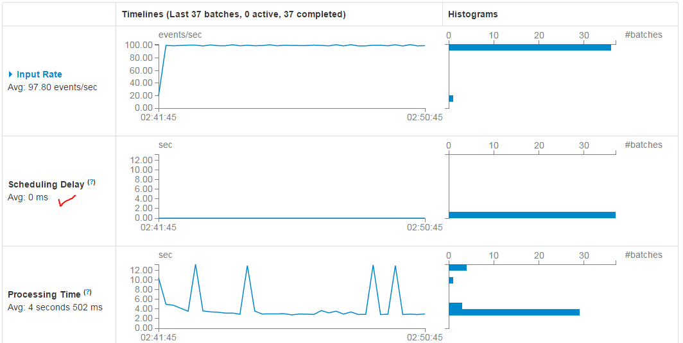
Spark UI
The Streaming tab in the Spark UI has several useful charts and metrics as shown below.

Slide 26
Flume
The standard method to write a Spark dataframe to Hadoop is: df.write.json('/tmp/mydata')
Unfortunately, this method, as well as all other standard methods in Spark, are unable to append to existing files so instead they create a new file for each partition of the underlying RDD.
Note: You can specify an "append" mode in the above function call, but it actually writes a new file into an existing directory instead of appending to existing files. This is a limitation of the underlying Hadoop library that Spark uses to write to Hadoop. So if we have 15 second batches and 4 Spark executors, we would end up with more than 23,000 files in just one day.
Flume can be used to avoid this problem very effectively. Flume can receive a stream of data from a variety of sources and write them to a Hadoop-compatible file system in an optimal way. We'll configure Flume so that it receives the enriched data from Kafka and writes them to ECS.

Slide 27
Flume
Each Flume agent will write to only one file at a time. Flume will flush the file every few seconds to ensure that the file system has the latest data. Any readers of the data will see the latest data up the most recent flush. When the file reaches an optimal size (we use 128 MiB), it will close the file and begin writing to a new file.
flume1.sources = kafka-source-1
flume1.channels = hdfs-channel-1
flume1.sinks = hdfs-sink-1
flume1.sources.kafka-source-1.type = org.apache.flume.source.kafka.KafkaSource
flume1.sources.kafka-source-1.zookeeperConnect = zk.example.com:2181
flume1.sources.kafka-source-1.topic = enriched_data
flume1.sources.kafka-source-1.batchSize = 100
flume1.sources.kafka-source-1.channels = hdfs-channel-1
flume1.channels.hdfs-channel-1.type = file
flume1.sinks.hdfs-sink-1.channel = hdfs-channel-1
flume1.sinks.hdfs-sink-1.type = hdfs
flume1.sinks.hdfs-sink-1.hdfs.writeFormat = Text
flume1.sinks.hdfs-sink-1.hdfs.fileType = DataStream
flume1.sinks.hdfs-sink-1.hdfs.filePrefix = enriched_data
flume1.sinks.hdfs-sink-1.hdfs.useLocalTimeStamp = true
flume1.sinks.hdfs-sink-1.hdfs.path = viprfs://repbucket1.ns1.site1/tmp/ecs_iot_demo2/enriched_data/%Y-%m-%d/site1
flume1.sinks.hdfs-sink-1.hdfs.rollCount=0
flume1.sinks.hdfs-sink-1.hdfs.rollInterval=0
flume1.sinks.hdfs-sink-1.hdfs.rollSize=134217728
flume.conf

Slide 28
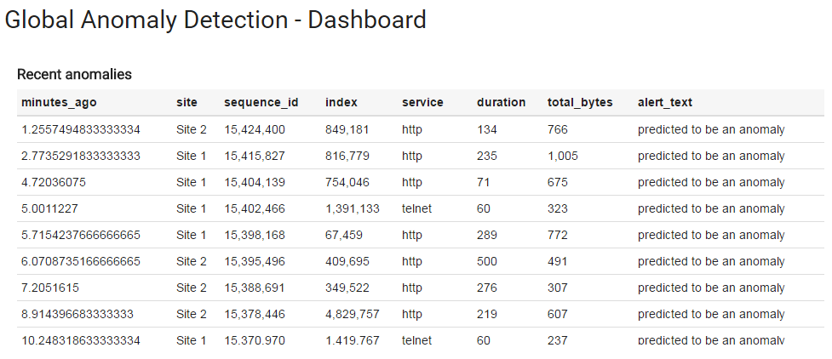
Zeppelin Dashboards and Exploration

Slide 29
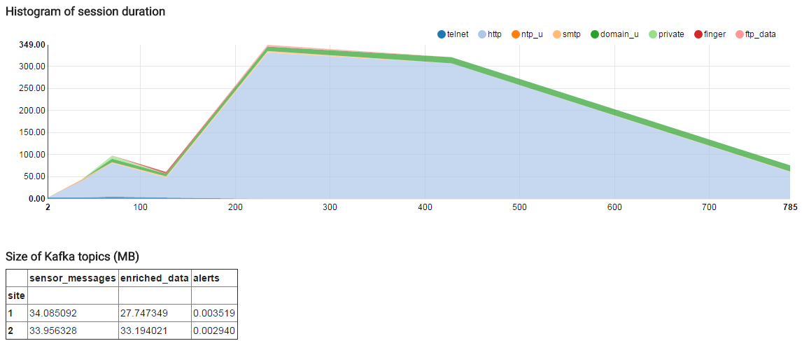
Zeppelin Dashboards and Exploration

Slide 30
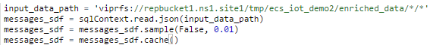
Zeppelin Integration with Spark
Zeppelin integrates directly with Spark and PySpark can be used interactively. The following will load a sample of 1% of the enriched data on ECS and cache it in Spark for fast interactive querying.

Slide 31
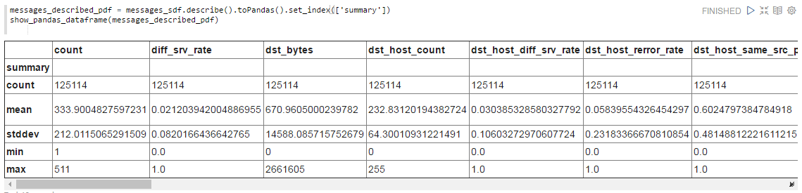
Zeppelin Integration with Spark
I can also show some statistics for each of the numeric columns in the enriched data.

Slide 32
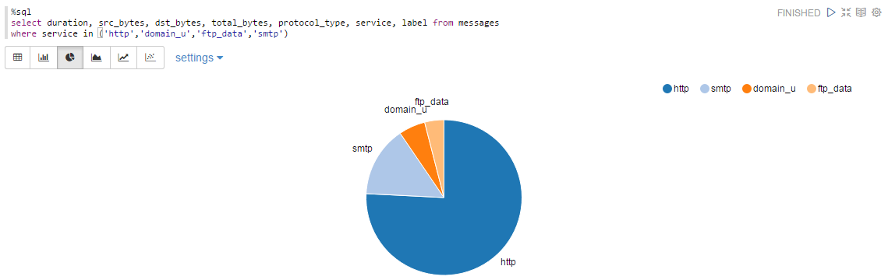
Zeppelin and SQL

Slide 33
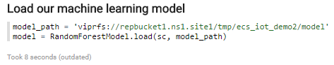
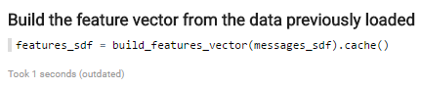
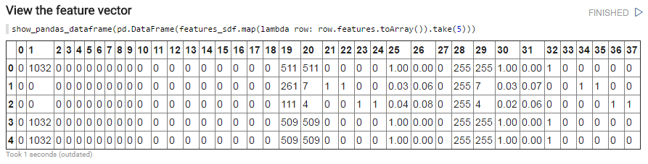
Zeppelin and Interactive Machine Learning
Zeppelin can also be used to perform machine learning tasks interactively. Since it supports PySpark, the code we type into PySpark can be easily copied to our Spark Streaming or Spark batch job. We could even put the code into a common Python library (e.g. common_pyspark.py) that is imported by multiple applications.

Slide 34
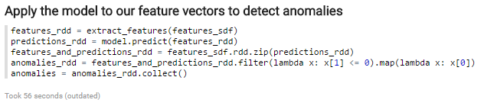
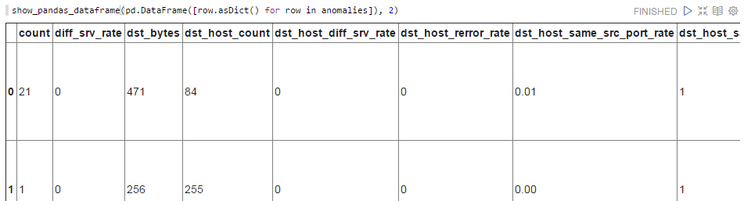
Zeppelin and Interactive Machine Learning

Slide 35

ECS made it easy to go "global."
There was no need to develop scripts and processes around using DistCp to copy files from one data center to another (and back).
We didn't need to worry about caching data locally or the harder problem of cache invalidation.
We didn't need complex disaster recovery / high availability processes (as far as the data storage is concerned).
Although this presentation is focused on anomaly detection, most of this architecture is general purpose and can be used for a wide variety of machine learning and other global Big Data use cases.

